Slide 1
PRESENTATION
ON
“OS SERVICES(Vinaya)”
Purnima Lal -160301120034
Biswajit Behura -1603011200052
Soumya Samar Brahma-160301120054
Ankita Singh-160301120055
Punyabrat Rath-160301120057

Slide 2
ABSTRACT
It is a free educational software.
It is proposed to demonstrate the basic OS concepts such as ,Process Scheduling ,Process Synchronization, Deadlock Avoidance, Page replacement Algorithm.
A website is created to download the Desktop Application and its documentation.

Slide 3
INTRODUCTION
It is an educational software with a GUI.
Public can download this software from the website.
This software aims to transform the theoretical concepts into graphical view.
User can give feedback in the e-mail id of any creators
The UI design is based on Microsoft’s Fluent and Metro UI Design languages. Web domain and hosting is done by help of AWS.
The software is coded in java and java swing and the website is coded in html and css.

Slide 4
PROJECT PURPOSE
It is proposed to demonstrate and verify basic Operating System Concepts.
This software changes the Theory into graphical view , So that user can verify the concepts.
The targeted audiences for this software are students and teachers, who have basic understanding of Operating System concepts, for practical implementation of topics

Slide 5
REQUIREMENT SPECIFICATION
Hardware Specification:-
- Processor – Intel Pentium & above
- RAM – 1.00 GB & above
- Hard Disk – 512mb & above
- System Type – 32 or 64-bit Operating System
-All platforms
Software Specification;-
- Java – version 8
- Runtime – Java(TM) SE Runtime Environment
- JDK – JDK 1.8.0_131
- Web Browser- Chrome, Firefox etc.

Slide 6
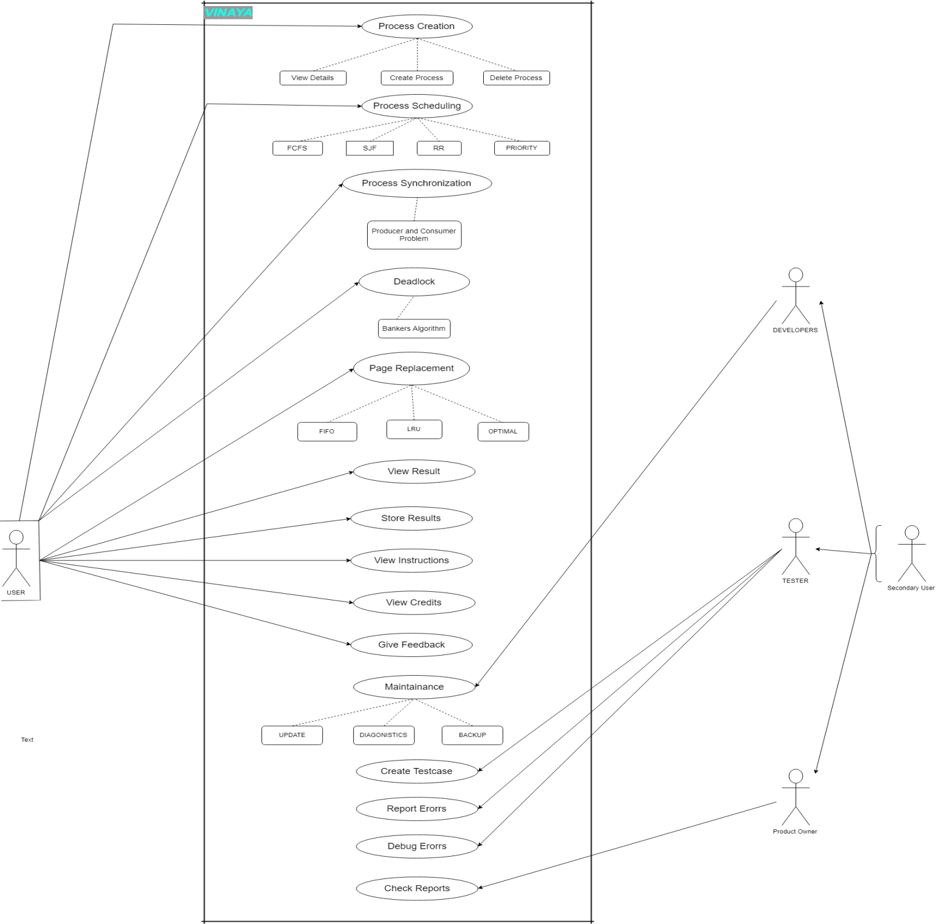
Use Case

Slide 7
DFD

Slide 9
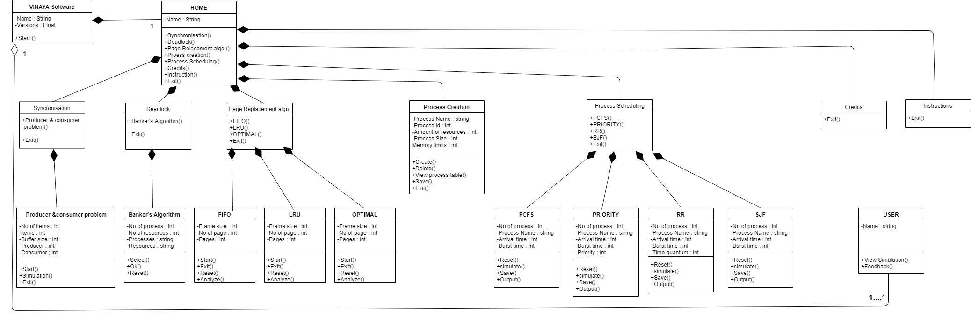
CLASS DIAGRAM

Slide 10
ANALYSIS
In Process Scheduling we analyze the burst time, Avg. Burst time, Turnaround time ,avg. turnaround time and completion time of the algorithms.
In Page replacement algorithm we analyze how replacement of pages takes place using different algorithm.
In Banker’s algorithm we check the safe state of the computer.
In Producer Consumer problem we analyze that how a producer produces the item in the buffer and how consumer consumes from the buffer.

Slide 11

DESIGN LAYOUTS
Launch Page

Slide 12
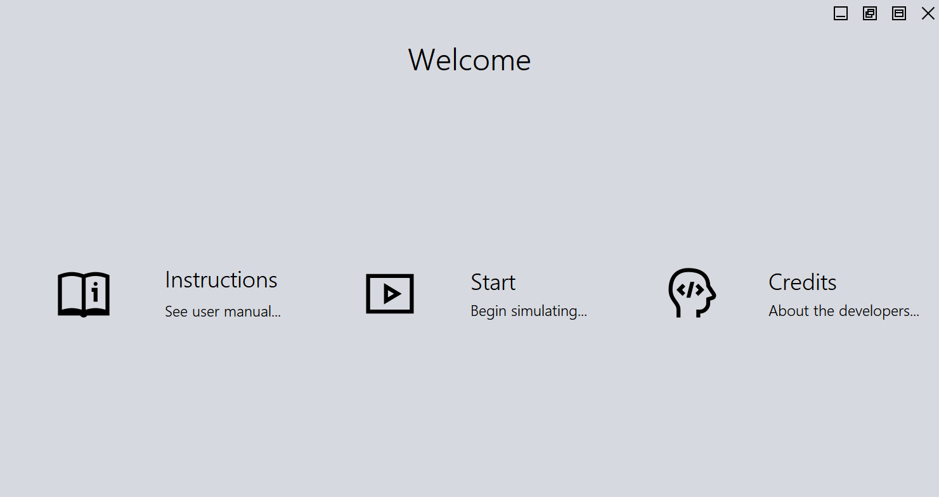
Welcome page

Slide 13
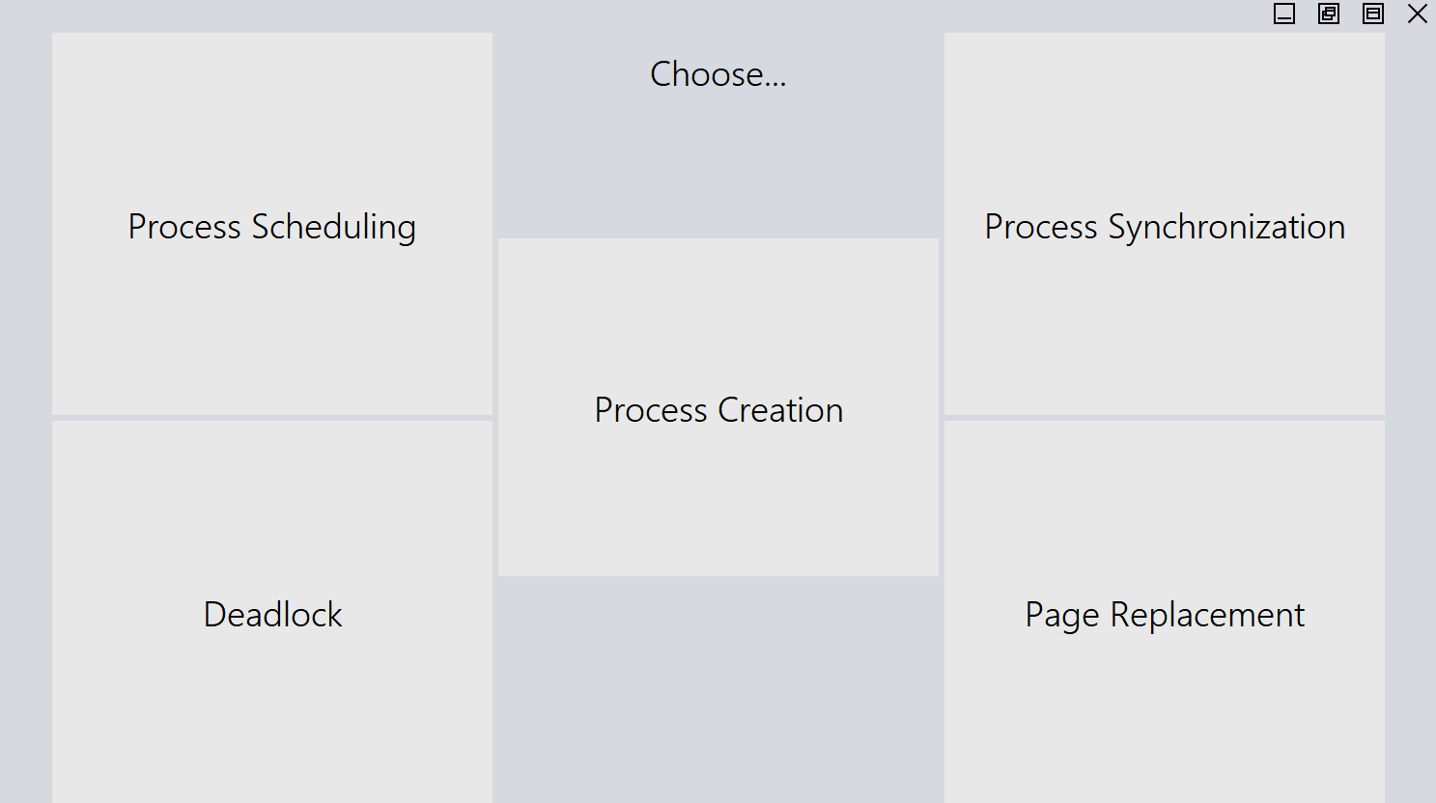
Home Page

Slide 14
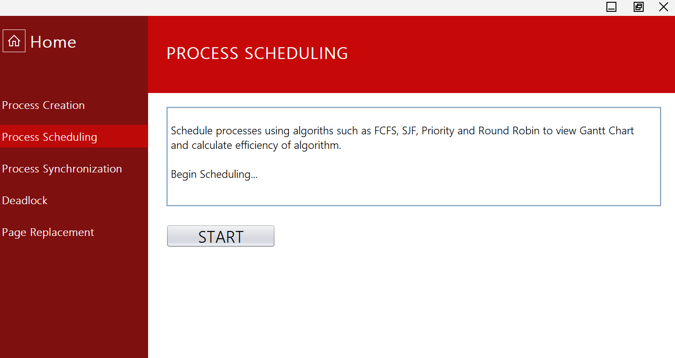
Process Scheduling 1

Slide 15
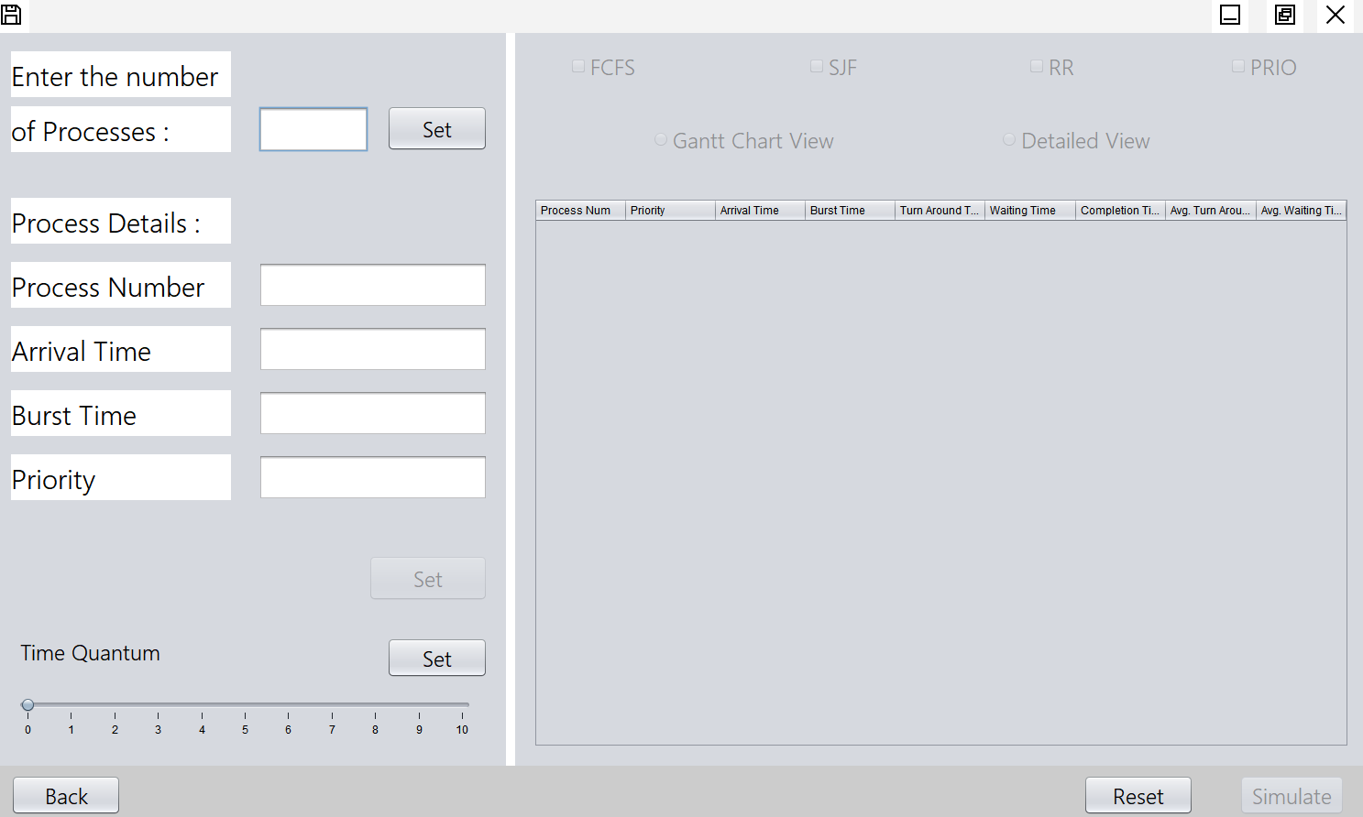
Process Scheduling 2

Slide 16
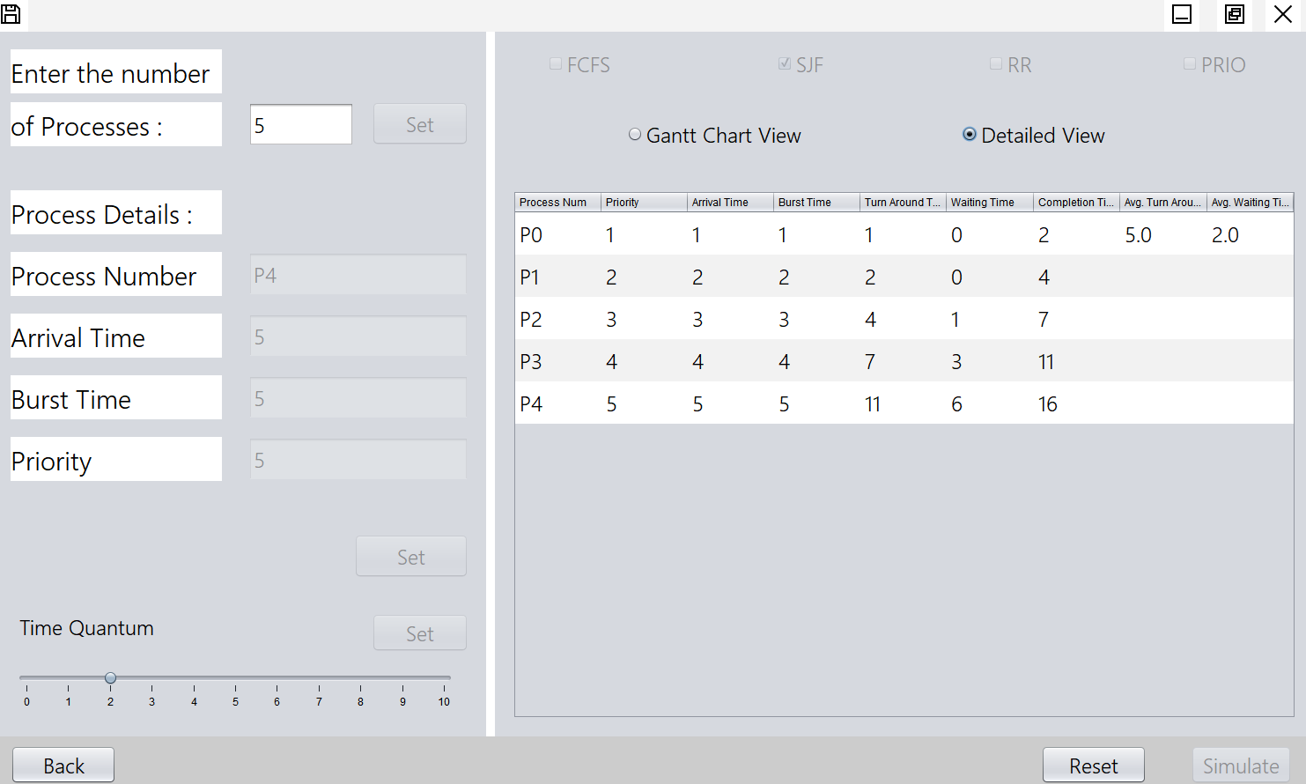
Process Scheduling (Detailed view)

Slide 17
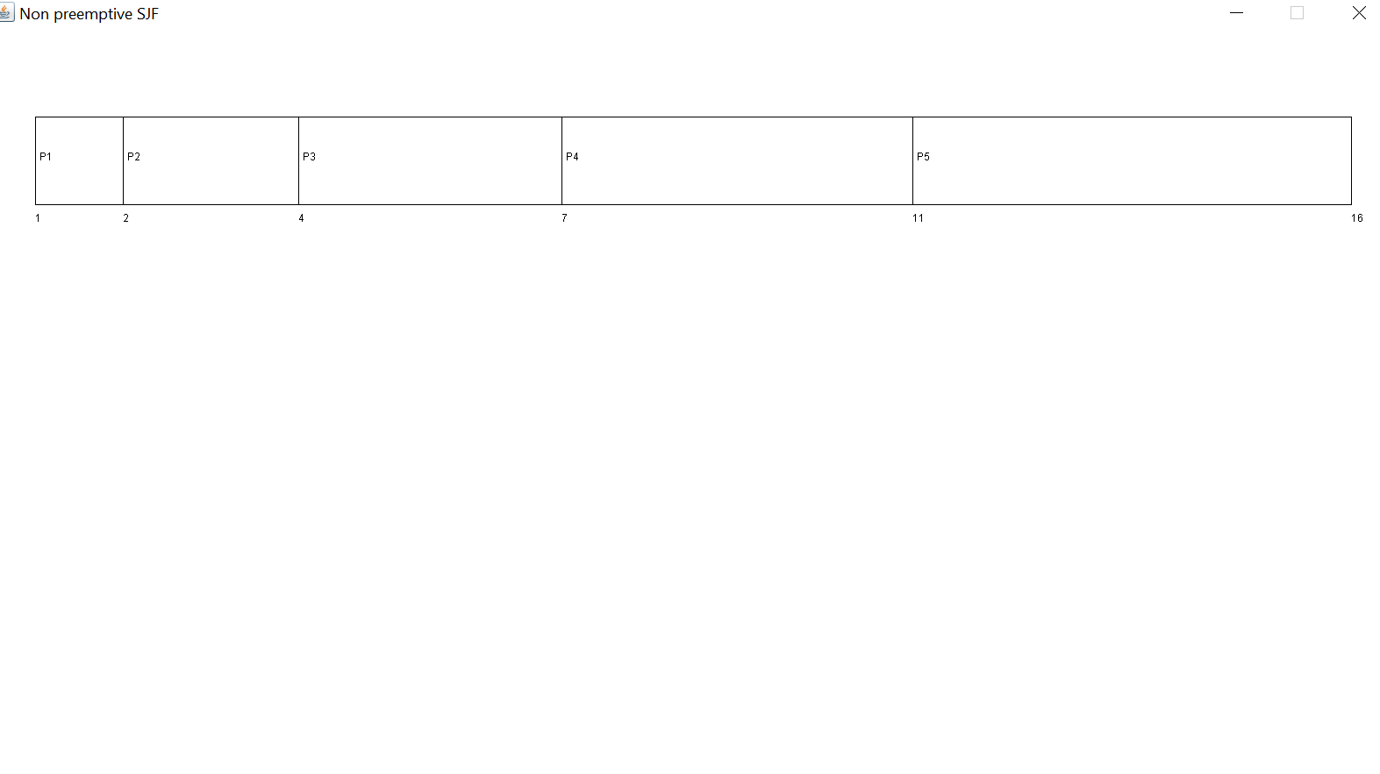
Process Scheduling (Gantt Chart)

Slide 18
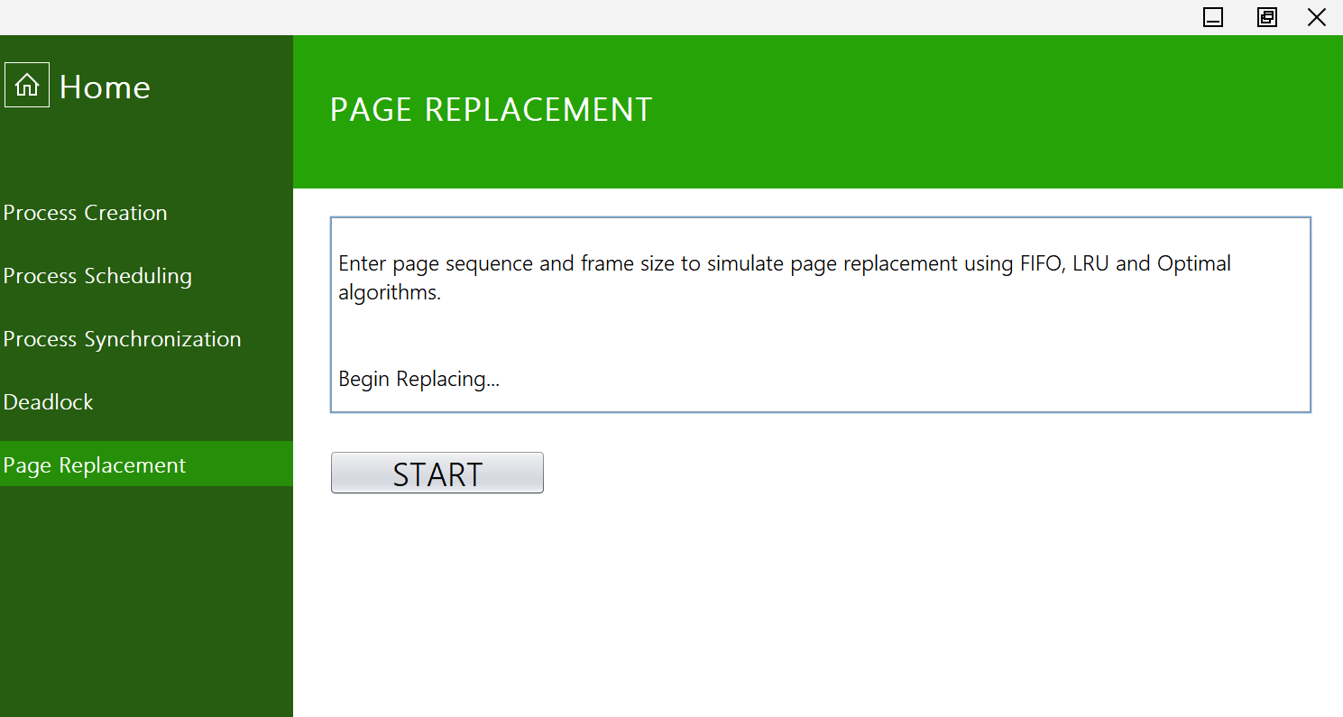
Page replacement 1

Slide 19
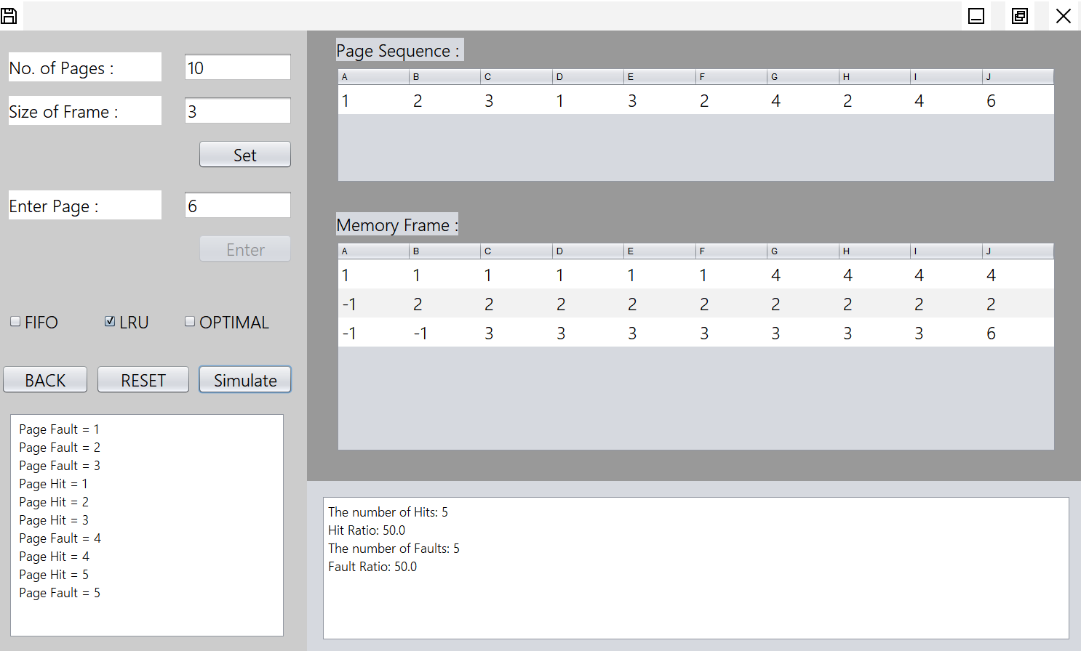
Page replacement 2

Slide 20
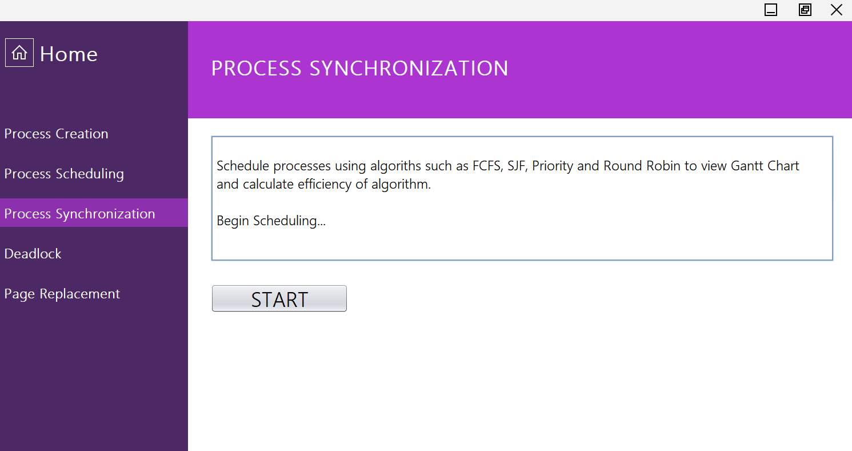
Producer consumer Problem

Slide 21
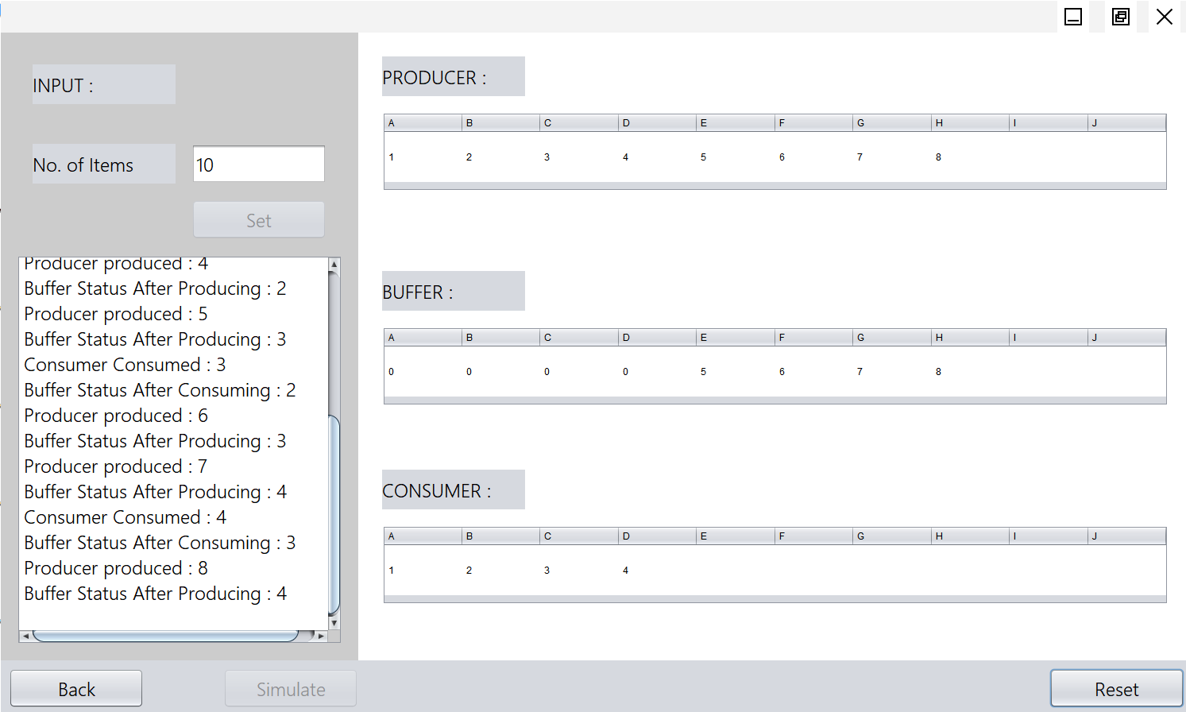
Producer consumer Problem

Slide 22
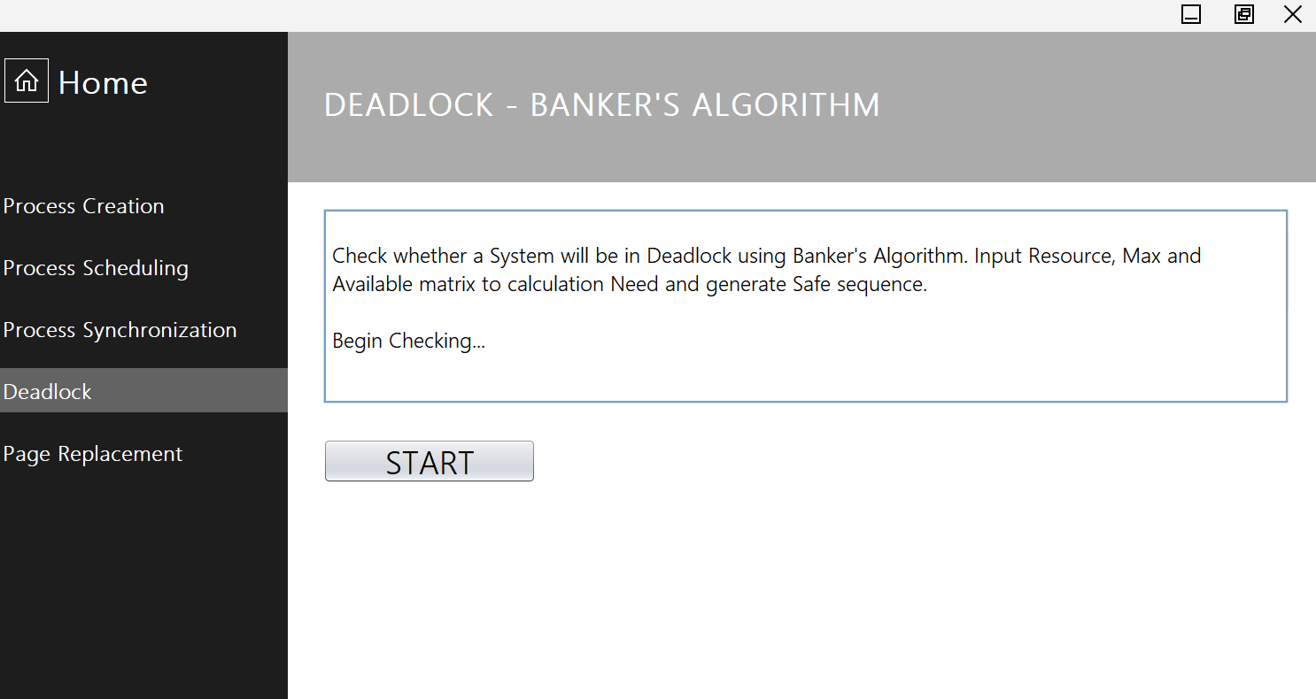
Banker’s Algorithm 1

Slide 23
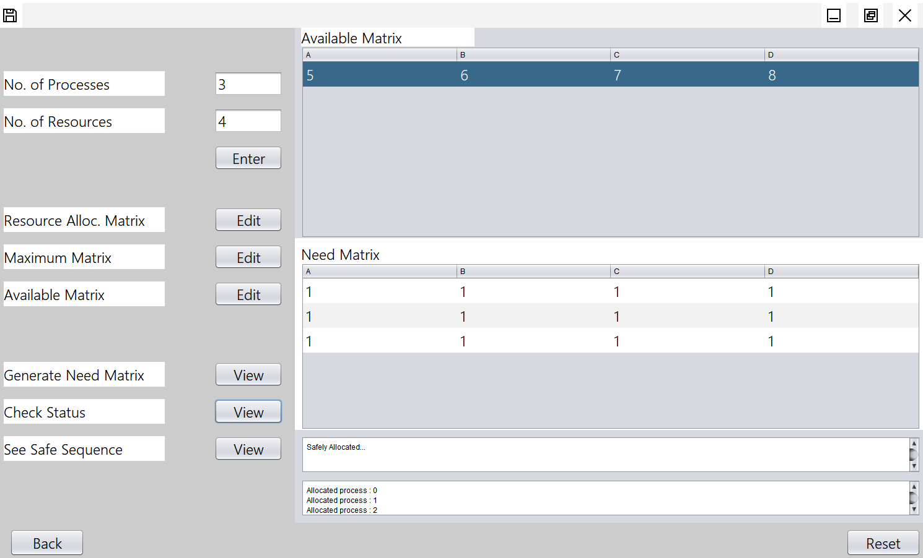
Banker’s Algorithm 2

Slide 24
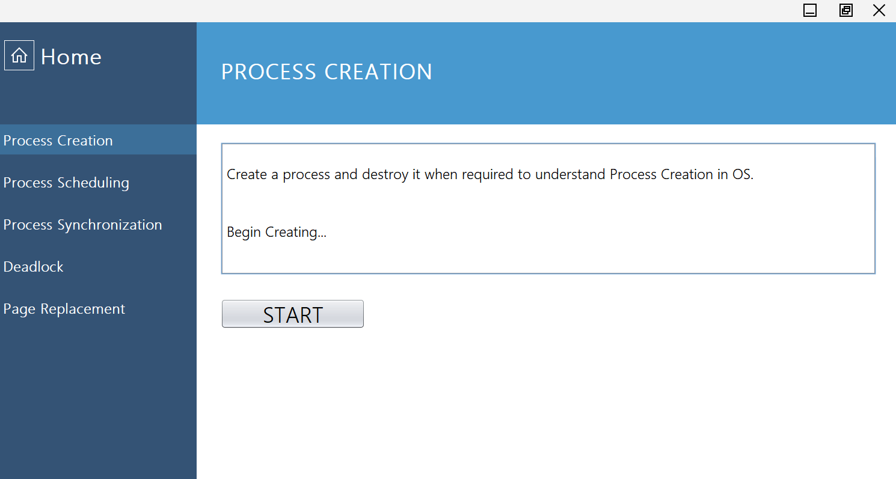
Process Creation 1

Slide 25
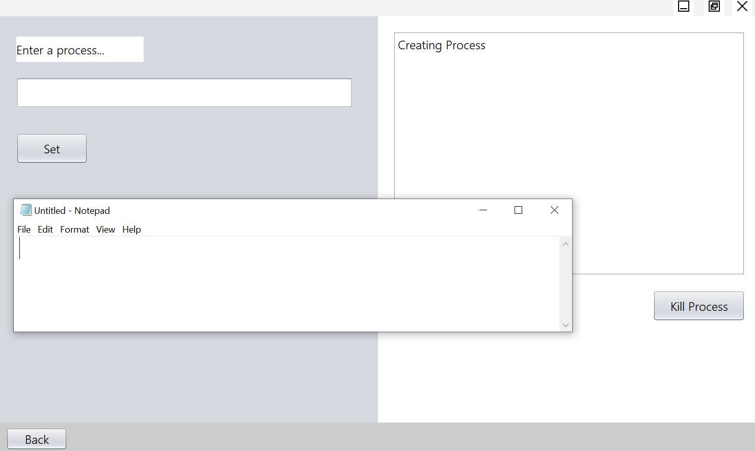
Process Creation 2

Slide 26
THANK YOU

